Slide 1
GENERATOR DESIGN: BENTHIC MICROBIAL FUEL CELLS for Long term Sensors Networks
Brandon Kelly
Mentored by dr. Jordon Beckler
FAU reu for renewable energy

Slide 2
Quick Background and terms
Benthic Microbial Fuel Cells
Electricity Producing Device Powered by Microbes in Sediment
Boost Converter
DC Analog to a Step-Up Transformers
LiPo Battery
A Lithium-Polymer Battery, Has High Energy Density
Capacitor
Stores Energy in Electric Field
Notes:
Keep it brief. Focusing on Caps as storage not for other properties

Slide 3
The Goal
Sediment Health is an Important Factor in Water Health
Use of BMFCs may Fight Algal Blooms
Long Term Sensors Allow Viewing of Seasonal Trends
BMFC can Power the Sensors Monitoring them

Slide 4
The components
Benthic microbial fuel cells
Sensors
Powered by Microbes living in the Benthic Zone
Power Density of ≈30mW*m⁻²
Typically has voltage between .4 - .7 V¹
Allow for Long-term Monitoring of Water Health
Most run at 3.3 V or 5V
Can require Hundreds of Milliwatts

Slide 5
Bringing it together
Dc-dc Conversion
Low Power sensors
Energy storage
Convert Fuel Cell Voltage to Usable Voltage
Able to Deal with Range of Input Voltages
Decent Efficiency
Remain Under Power Budget
Store or Transmit Relevant Data
Scalable Monitoring Solution
Store Excess Energy
Handle Spikes in Load
Not Degrade over Time

Slide 6
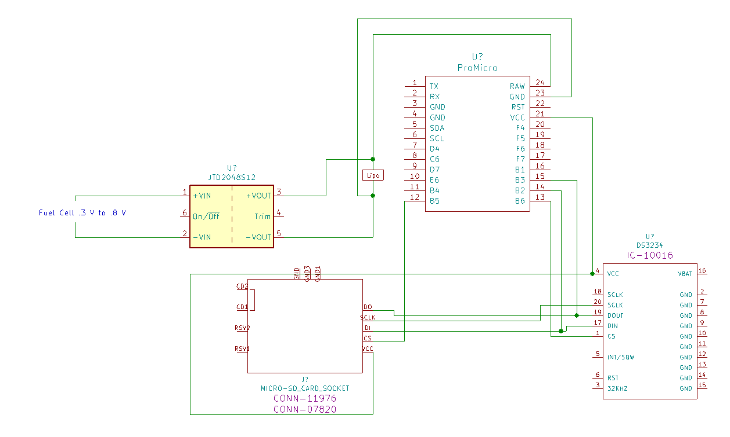
Goals for upcoming week
Wire Sensor Together
Generate Polarization Curve
Begin Research on Best Storage Method
LiPo Battery
Ubiquitous, Power Dense, Simple Power
Capacitor Storage
Cheap, Simple Charging, Resilient
Hybrid Model?

Slide 7
Questions?
Sources:
1:Girguis, P.R., M.E. Nielsen, C.E. Reimers. 2010. Fundamentals of Benthic Microbial Fuel Cells: Theory, Development, and Applications. In Bioelectrochemical Systems. First edition. Springer Verlag Press. http://nrs.harvard.edu/urn-3:HUL.InstRepos:42667156

